Slide 1
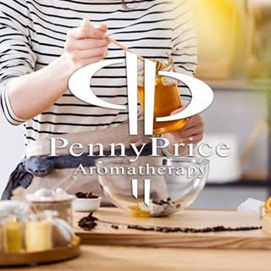
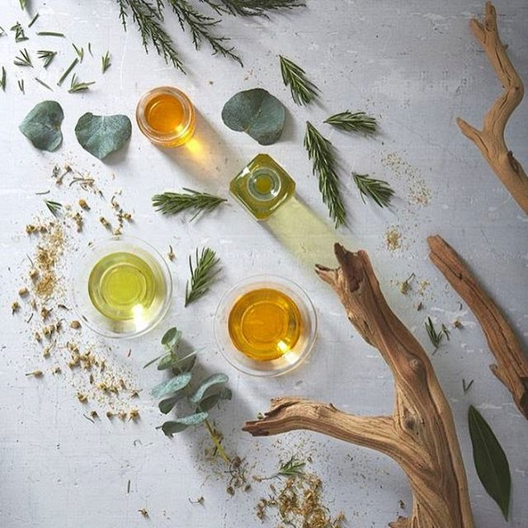
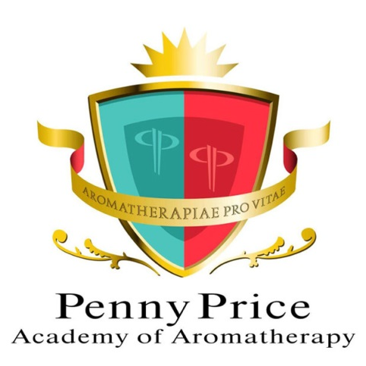
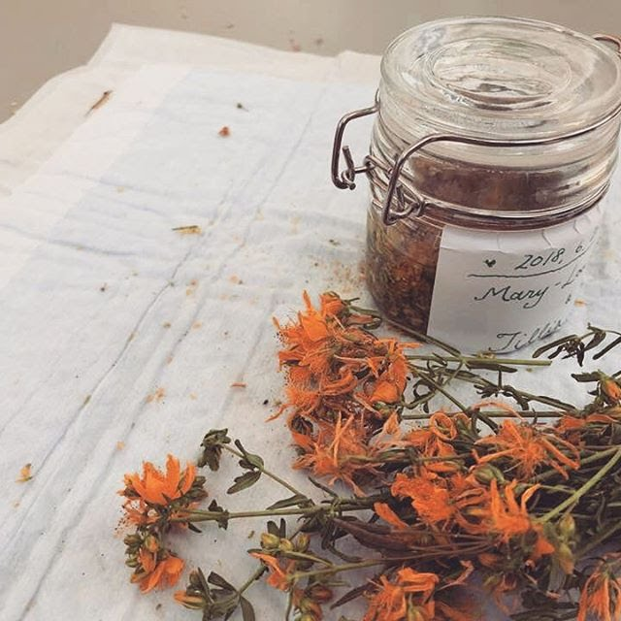
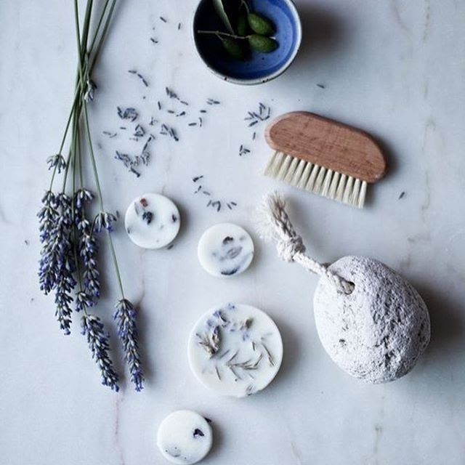
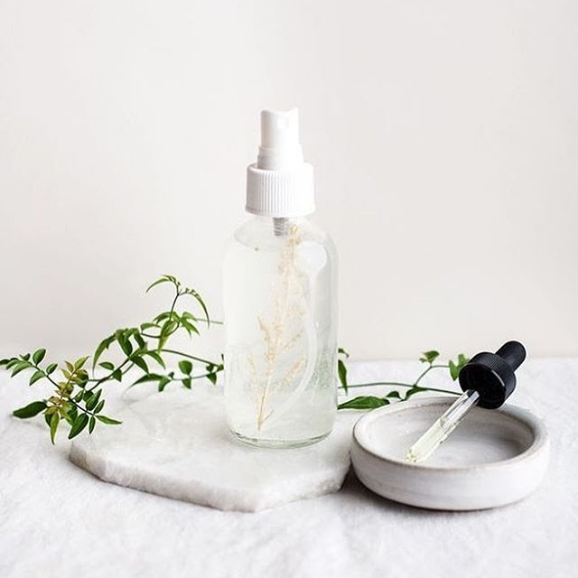
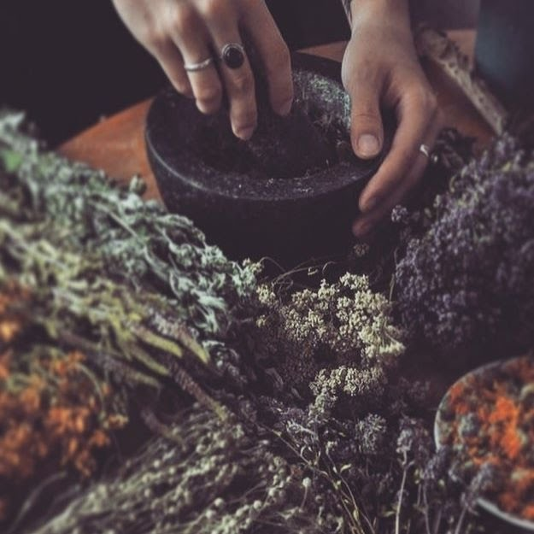
Welcome to…
Penny Price Academy
of Aromatherapy
Saturday Club
Winter Warming Oils

Slide 2
What does the cold do to our bodies?
Penny Price Academy
Saturday Club
December 2023
Cold weather can put increased stress on our cardiovascular system. Cold temperatures cause your blood vessels to constrict, shallow breathing, and a slight thickening of the blood.
It can also cause problems for asthma sufferers because cold, dry air causes the air passages in the lungs to contract, making it difficult to breathe.
Cold, dry air can also worsen conditions such as eczema by drying out the skin.
Warmth tends to relax us whereas cold can put us on edge.
People may sleep longer – but paradoxically feel more tired than usual. It can be hard to concentrate and make you feel on edge.

Slide 3
What are warming oils good for?
Penny Price Academy
Saturday Club
December 2023
Coughs, colds and shivers
Chest complaints
Reduced immunity
Digestive issues
Joint pain
Muscle pain
Loneliness
Depression and SAD
Grief

Slide 4
Cardamom (Elettaria cardamomum)
Penny Price Academy
Saturday Club
December 2023
This oil has been described as ‘stimulation balanced with relaxation!’ (Peter Holmes). It is high in 1,8 cineol which means it will be anti-inflammatory and anti infective. It also contains esters which are generally calming and gentle.
Due to the 1,8 cineol, cardamom is useful in treating respiratory conditions and viruses such as colds and ‘flu where it is warming as well as effective in killing the cause of the illness.
Physically it is good for cold conditions of the digestive tract such as stress induced indigestion with bloating, flatulence and poor appetite. It is also good for muscle spasm in the digestive system.

Slide 5
Cardamom (Elettaria cardamomum)
Penny Price Academy
Saturday Club
December 2023
Holmes suggests that cardamom is tailor-made for the individual suffering from chronic depression with anxiety and exhaustion.
It is said to be particularly good when there is poor quality sleep followed by exhaustion and low energy in the morning.
It is recommended for chronic fatigue syndrome and therefore perhaps long covid where there is exhaustion.
Cardamom is good for poor self confidence and emotional inhibition.

Slide 6
Benzoin (Styrax benzoin)
Penny Price Academy
Saturday Club
December 2023
Benzoin is a beautiful warming oil which is comforting to many ‘cool‘ conditions both physically or mentally.
It has an ability to gently stimulate as well as soothe, it seems to ‘get things moving’ in the body, whether it be to clear mucus, stimulate the circulation, expel gas or increase the flow of urine.
Benzoin is a valuable treatment for colds, flu and bronchitis .Its value as an inhalation for sore throats and loss of voice is probably its best known use.
Its stimulating properties help to clear mucus off the chest (make up a blend in carrier oil to rub into the chest). It can also be used in steam inhalations for congested chests and even middle ear infections

Slide 7
Benzoin (Styrax benzoin)
Penny Price Academy
Saturday Club
December 2023
The combination of benzoin’s balsamic and vulnerary properties make it effective in the treatment of chapped skin, chilblains, frostbite and cuts.
It is a valuable antiseptic for the urogenital tract, in both males and females. Its antiseptic properties make it useful for treating urinary infections of a cold, damp nature. This includes cystitis, urethritis characterised by a cramping pain and pale cloudy urine.
On a psychological level Benzoin is deeply soothing, comforting and nurturing . Patricia Davis recommends it for sadness and loneliness, both cold feelings.
Mojay states that “the ability of benzoin to help calm, centre and reassure also makes it suitable for those who feel emotionally needy and neglected”

Slide 8
Bitter Orange (Citrus aurantium var amara)
Penny Price Academy
Saturday Club
December 2023
Penny Price Academy
Saturday Club
October 2023
The bitter orange flower and bitter orange oil are used for gastrointestinal disorders including stomach ulcers, constipation, diarrhoea, cramps and intestinal gas.
It has also been recommended for regulating fat levels in the blood and lowering blood sugar in people with diabetes
In 2013 a study was carried out on 126 women in labour to see if bitter orange oil helped in labour pain. The results of the study showed that it did reduce the pain. ‘The method is recommended for implementation as an approach to reduce labour pain based on its low cost, ease of application, and non-invasiveness.’

Slide 9
Bitter Orange (Citrus aurantium var amara)
Penny Price Academy
Saturday Club
December 2023
Penny Price Academy
Saturday Club
October 2023
Bitter Orange essential oil is a good general skin tonic and can help detoxify congested skin. It is particularly beneficial for acne, older, mature skin, dry irritated skin and dermatitis. Research has shown that it might be effective for treatment of fungal skin infections.
It is also beneficial for chronic fatigue syndrome as it boosts the immune system, uplifts and detoxes the system and is good for general tiredness.
In Ayurvedic medicine bitter orange oil is used for meditation practice and it is said that afterwards you will feel fresh and more confident.
Like sweet orange, bitter orange oil is a cheery and uplifting oil and can be beneficial for anxiety and stress

Slide 10
A blend for depression
Penny Price Academy
Saturday Club
December 2023
The sense of smell is very important when treating depression so try making up a nasal inhaler (6-10 total drops of essential oils) or a roller ball ( 3-6 total drops of essential oils to 10 mls of carrier oil).
Benzoin - comforting and warming
Bitter Orange - calming and uplifting
Cardamom - chronic depression with anxiety and exhaustion.
Also
Marjoram - acute and agitated depression
Patchouli - calming and grounding.

Slide 11
Myrrh
(Commiphora molmol)
Penny Price Academy
Saturday Club
December 2023
Myrrh essential oil is antibacterial, antimicrobial, antifungal and anti-inflammatory.
Holmes states that myrrh is ‘one of the finest astringents for weak, loose or boggy tissues.’ ‘It is a healing, strengthening protecting bandage’.
In the gut it will heal tissues and is an anti-inflammatory for spongy, leaky, inflammatory conditions such as IBS. If there is dysbiosis (imbalance of the composition of the microbiome) its antimicrobial action will help remove pathogenic bacteria and restore balance.

Slide 12
Myrrh
(Commiphora molmol)
Penny Price Academy
Saturday Club
December 2023
It is excellent for skin care particularly for wounds and ulcers especially if they are slow to heal. It is also good for athlete’s foot, cracked skin and chilblains.
Myrrh is an excellent expectorant and is good for all types of chest infections especially if chronic.
Mojay suggests that myrrh oil’s effect on the spirit is one of stillness and peace, it is recommended for overthinking, worry and mental agitation and therefore good for meditation.
Like cypress and marjoram it can ease sorrow and grief.

Slide 13
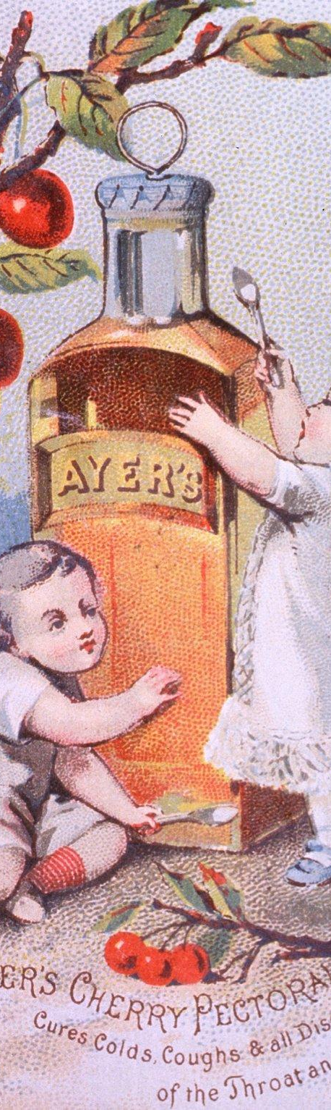
A blend for coughs and colds
Penny Price Academy
Saturday Club
December 2023
Try making a chest rub with a total of 3 drops of essential oils to 10 mls of carrier oil.
Myrrh - good for chronic chest conditions
Benzoin - warming, removes mucus, good for loss of voice
Marjoram - good for coughs, opens up the bronchi
Also
Cardamom - warming and kills viruses
Don’t forget a decongestant nasal inhaler (6-10 total drops of essential oil) with eucalyptus and lavender. You could also try adding the same two oils with some thyme ct linalool to a bowl of steaming water,

Slide 14
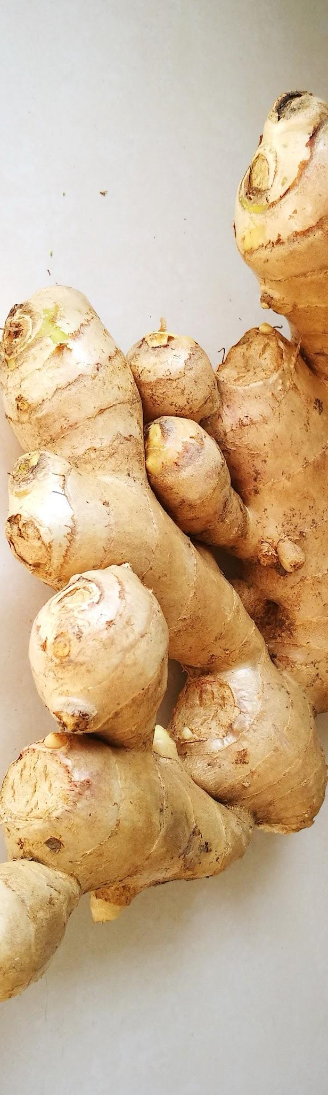
Ginger (Zingiber officinale)
Penny Price Academy
Saturday Club
December 2023
Ginger is warming, stimulating and gently pain relieving.
It has been used for centuries to help with inflammation. Zingibain, is a component of ginger responsible for its anti-inflammatory properties.
In recent times there has been numerous studies showing that it is not only significantly anti-inflammatory but can also reduce the feeling of pain.
In one study it reduced exercise induced pain by 25% and in another they found that after using ginger oil people with arthritic pain were able to reduce their pain medication.
Hot compresses and massage blends with ginger are excellent for relieving all types of pain but particularly lower back issues.

Slide 15
Ginger (Zingiber officinale)
Penny Price Academy
Saturday Club
December 2023
Ginger is often used for stomach upsets. It is one of the best remedies for most stomach and bowel related problems.
Its ability to relieve nausea makes it useful for travel and morning sickness, especially when combined with orange or roman camomile essential oils. Ginger tea is also used for relieving stomach problems.
Ginger is warming stimulant to circulation and is recommended for chronic cold conditions of the respiratory, digestive, reproductive and musculoskeletal systems.
Mojay recommends it for boosting confidence and morale, invoking people’s ‘vital fire’ when they are procrastinating and doubting themselves.

Slide 16
A blend for digestive issues
Penny Price Academy
Saturday Club
December 2023
Try making a blend to rub into the tummy in a clockwise direction, to either 10mls of carrier oil or white lotion add a total of 3 drops of:
For Irritable Bowel Syndrome
Ginger - warming, calming, anti-inflammatory
Myrrh - heals tissues, good for IBS
Cardamon - muscle spasm and stress
For constipation and stagnation
Marjoram - help with constipation and peristalsis
Black pepper - stimulant, antispasmodic
Also
Patchouli - restorative, reduces mucus

Slide 17
Patchouli
(Pogostemon patchouli)
Patchouli essential oil is anti-inflammatory, antifungal, antiseptic and also a cell regenerator making it excellent for use in treating acne, impetigo, cracked skin, some eczema, athlete’s foot and dandruff.
It is a gentle oil and helpful with mature or aged skin. It can be helpful with the regrowth of skin cells and scar tissue.
It is also effective against the herpes simplex virus, which causes cold sores.
Penny Price Academy
Saturday Club
December 2023

Slide 18
Patchouli
(Pogostemon patchouli)
Patchouli is healing for both the nervous system and the digestive tract and is therefore excellent for any digestive issues that are aggravated by stress. Holmes also states that it can reduce mucus overproduction, restores intestinal lining and reduces fungal dysbiosis.
Holmes suggests that patchouli is grounding and can give security when one is threatened.
Mojay suggests that it is good for people who overthink and as a consequence feel out of touch with themselves.
Penny Price Academy
Saturday Club
December 2023

Slide 19
A recipe for chilblains and chapped skin
Penny Price Academy
Saturday Club
December 2023
To 10 mls of white lotion add a total of 3 drops of any of the following essential oils. Massage it into affected areas twice a day to help boost the circulation. Put warm socks or gloves on afterwards.
Myrrh
Benzoin
Patchouli
Black pepper one drop in a blend will improve circulation.

Slide 20
Black Pepper
(Piper nigrum)
Penny Price Academy
Saturday Club
December 2023
Black Pepper is very warming and promotes localised blood flow through tissues. It is one of the most stimulating oils, wonderful in a pre-sports rub to loosen muscles, as well as in a pain reliever for overworked muscles to relieve stiffness and fatigue.
It is remarkably beneficial for digestion. It stimulates the whole digestive system, right from the salivary glands in the mouth to the large intestine, promoting secretion of digestive juices like acids and bile into the ingested food, thereby facilitating digestion. It can be used to help a sluggish digestive system and will help soothe the smooth muscle of the gut.

Slide 21
Black Pepper
(Piper nigrum)
Penny Price Academy
Saturday Club
December 2023
As Black Pepper is warming and is strongly analgesic and anti-inflammatory, it is recommended for chronic cold, damp-type rheumatic and arthritic disorders. It can be a skin irritant so use in small dilutions combined with anti-inflammatory oils such as camomile.
This oil is useful in the treatment of fibromyalgia as it reduces pain, warms muscles, improves circulation and reduces stiffness
Peter Holmes states that ‘working as an arterial circulatory stimulant, Black pepper excels at treating fatigue and cold especially when chronic and when involving adrenal fatigue.’
Black pepper is said to be useful for indifference, lethargy, melancholy and mental fatigue. Black pepper is also said to help us move on when our lives feel stuck.

Slide 22
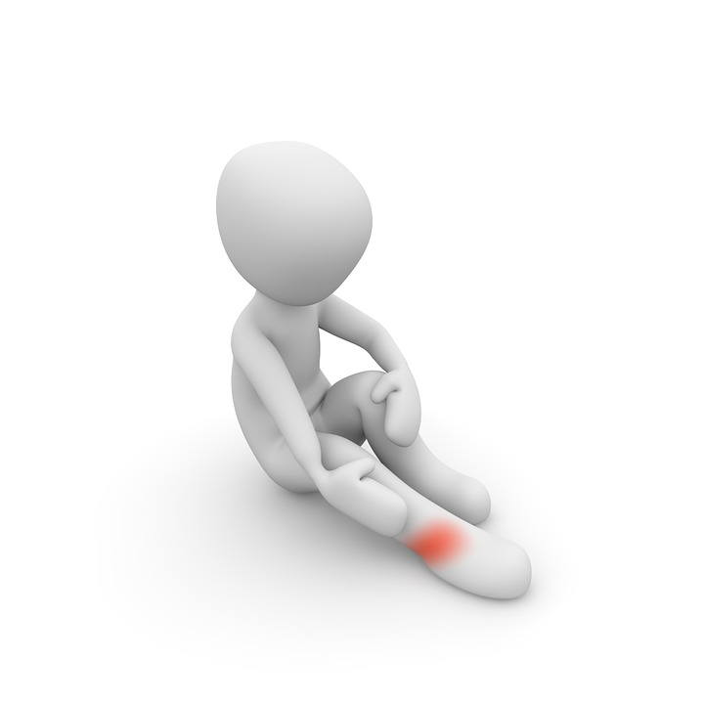
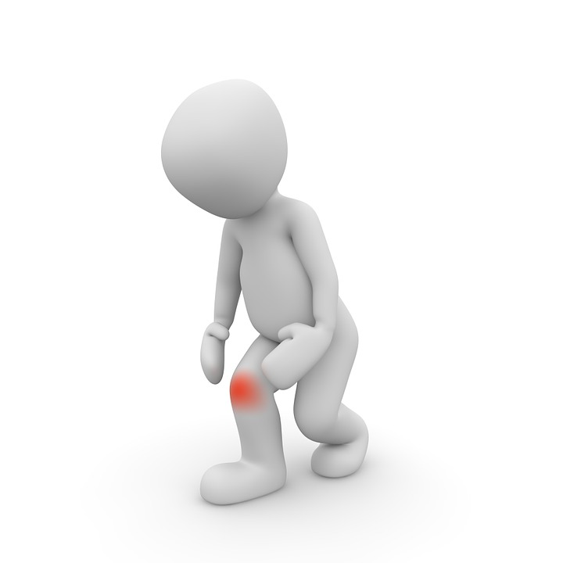
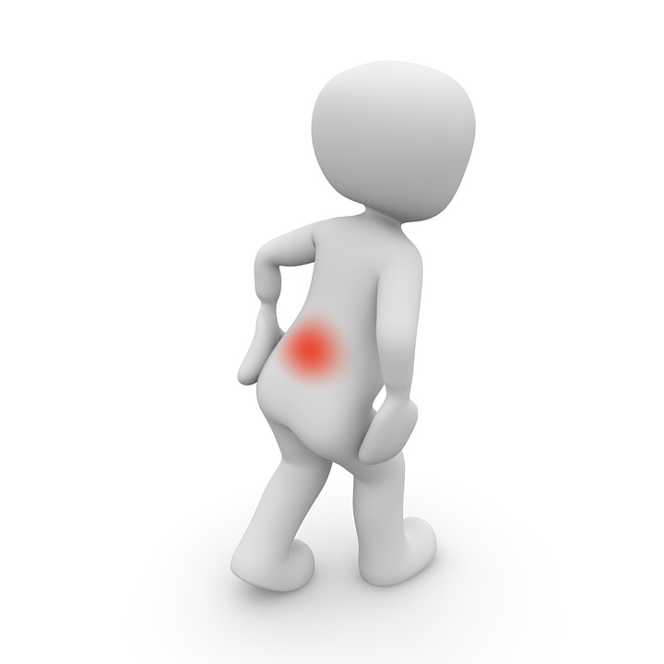
A blend for aches and pains
Make a blend using either a carrier oil or a white lotion. Remember carrier oils such as evening primrose and comfrey are anti-inflammatory and can help with muscular and joint pains.
To 10 mls of cream or carrier oil add a total of 3 drops of:
Marjoram - antispasmodic, opens up blood vessels
Ginger - warming, anti-inflammatory, reduces pain.
Black pepper - reduces pain, warms muscles, improves circulation and reduces stiffness
Penny Price Academy
Saturday Club
October 2023
Penny Price Academy
Saturday Club
December 2023

Slide 23
Marjoram (Origanum majorana)
Penny Price Academy
Saturday Club
December 2023
Penny Price Academy
Saturday Club
October 2023
The outstanding property of marjoram oil is its warming quality, whether inhaled or applied to the skin. It improves circulation and warms up the body.
In digestive upsets marjoram soothes colicky stomachs and intestinal pains, relieves flatulence, and has a generally warming effect when massaged gently into the stomach. It also helps relieve constipation as it strengthens the contractions (peristalsis) of the intestinal walls (massage into the stomach in a clockwise direction).
In high blood pressure and heart conditions Marjoram helps by dilating blood vessels and thus taking the strain off the heart. It can also be used to calm and regulate the heart, making it effective for palpitations, tachycardia and hypertension.

Slide 24
Marjoram (Origanum majorana)
Penny Price Academy
Saturday Club
December 2023
Penny Price Academy
Saturday Club
October 2023
Marjoram essential oil is helpful with all types of spasms and resultant problems. It efficiently relieves spasms in the respiratory system, intestines and muscular spasms in limbs. It also helps muscle pulls and cramps.
As a vasodilator, marjoram can help open up the bronchi in the lungs making it easier for the person to inhale. Its antispasmodic properties can also help in coughing fit and when someone finds it hard to breathe.
The warming qualities of marjoram together with its action on the blood vessels make it an excellent oil in the treatment of migraines. One of the possible causes of migraines is an insufficient blood supply to the brain due to muscular tension in the back of the neck, marjoram can help relieve the tension and dilate the blood vessels.

Slide 25
Marjoram (Origanum majorana)
Penny Price Academy
Saturday Club
December 2023
Penny Price Academy
Saturday Club
October 2023
A hot bath with marjoram oil combined with lavender and tea tree at the first sign of a chill can often prevent a cold from developing. Marjoram is warming and will also help sleep, whilst tea tree and lavender can work on the virus.
Marjoram is useful for insomnia especially when combined with lavender.
For depression, it is warming and comforting, it is recommended for anxiety with fatigue, agitated depression and nervous breakdown. Mojay suggests that marjoram is effective when used on people who worry and overthink, especially if they feel emotional deprivation as if ‘nobody cares’.
Both Patricia Davis and Gabriel Mojay indicate that marjoram can be comforting for the bereaved, indeed, the Greeks knew it as the ‘funeral herb’.

Slide 26
A recipe for grief
Penny Price Academy
Saturday Club
December 2023
Make up a nasal inhaler (6-10 total drops of essential oils) a roller ball ( 3-6 total drops of essential oils to 10 mls of carrier oil) or add 3-4 drops of essential oils to a diffuser.
Benzoin - warming and comforting
Marjoram - known as the funeral herb, warming
Bitter orange - uplifting
Myrrh offers strength, comfort and peace

Slide 27
A beautiful recipe for loneliness
Penny Price Academy
Saturday Club
December 2023
Make up a nasal inhaler (6-10 total drops of essential oils) a roller ball ( 3-6 total drops of essential oils to 10 mls of carrier oil) or add 3-4 drops of essential oils to a diffuser.
Benzoin - a warm hug in a bottle, good if you feel needy and neglected
Rose - comforting and healing
Petitgrain - calming good for insomnia when due to loneliness or
Bitter orange is cheery and uplifting but can also give you peace

Slide 28
