Slide 1
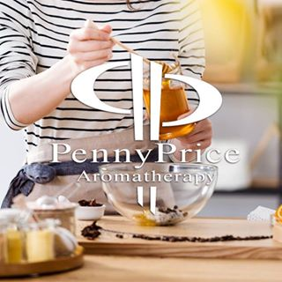
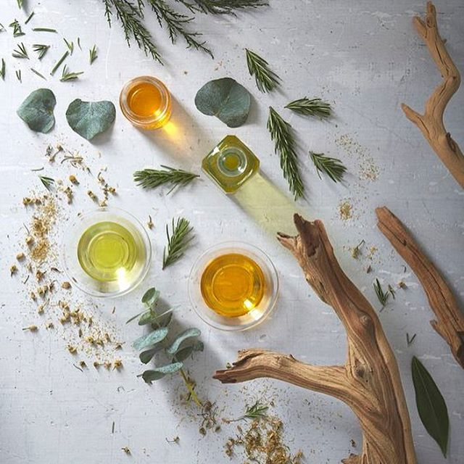
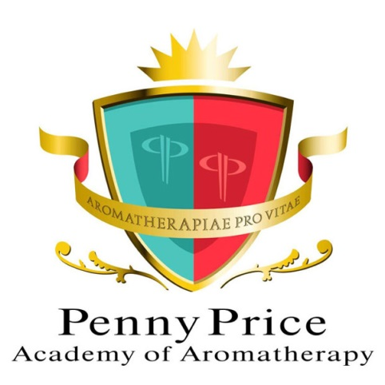
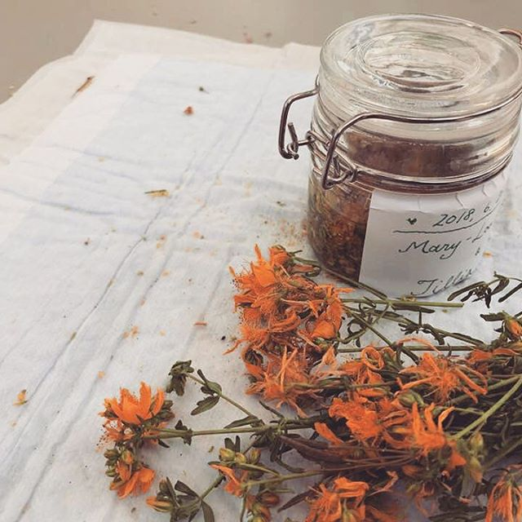
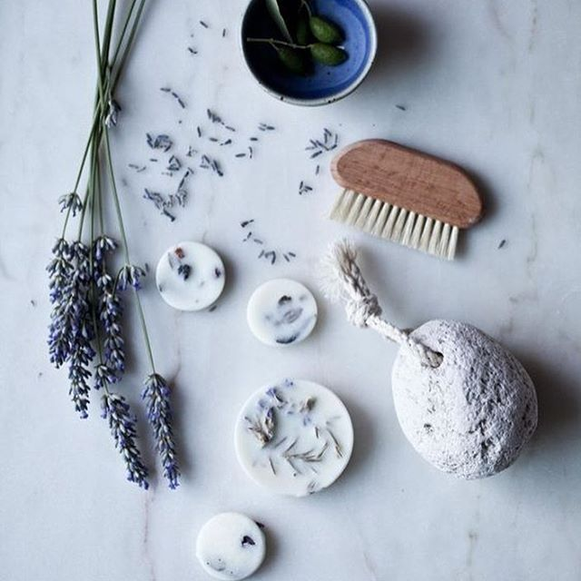
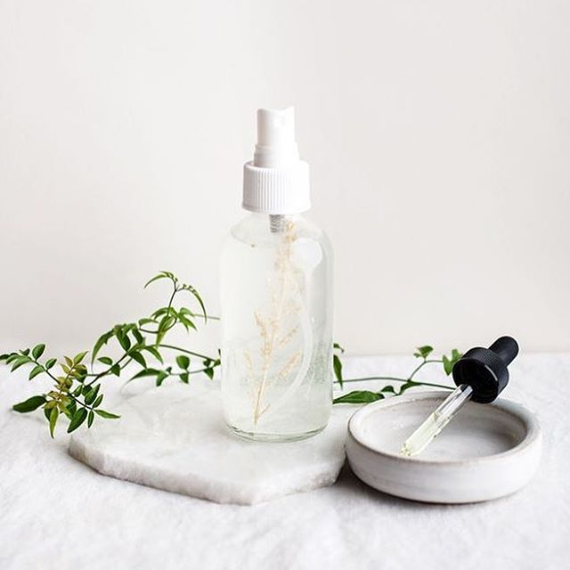
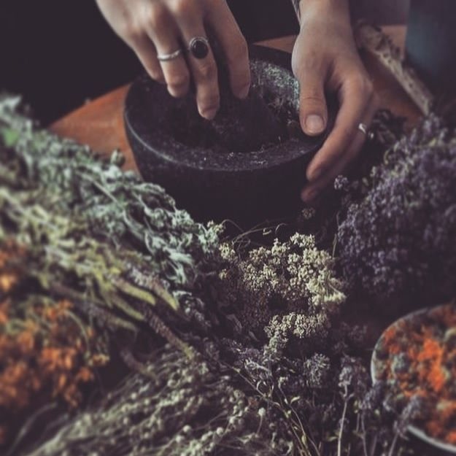
Welcome to…
Penny Price Academy
of Aromatherapy
Saturday Club
Aromatherapy for
Overindulgence

Slide 2
Defining overindulgence & the festive season
Penny Price Academy
Saturday Club
Jan 2024
Overindulgence is defined the action or fact of having too much of something enjoyable
It is an excess or an amount of something that is more than necessary, permitted, or desirable.
Rich foods and alcohol are synonymous with the holiday season but can then leave us feeling bloated, tired and with low motivation.
Many people participate in new year diets so there is the “last hurrah” at the end of December.
This Photo by Unknown Author is licensed under CC BY-NC-ND

Slide 3
Hedonic hunger or something else?
Penny Price Academy
Saturday Club
Jan 2024
Hedonic hunger is the desire to eat for pleasure, as opposed to consuming the calories your body needs for energy.
Comfort eating is a type of eating that causes your brain to release endorphins, which are feel-good hormones. So, eating feels good for a lot of people.
We are as a species drawn to high sugar/energy foods as this is what we are genetically predisposed to hunt for.
There is also social pressures at play if out with a group of people.
This Photo by Unknown Author is licensed under CC BY

Slide 4
Using Aromatherapy
Penny Price Academy
Saturday Club
Jan 2024
Today we will be looking at using essential oils and hydrolats to aid some of the symptoms that are left after we have over indulged.
There are many other lifestyle changes we can do such as drinking more water, adding more fresh fruits and vegetables to your diet and moving the body more.
There is also the mental side of the aftermath of indulging and the pressure of a new year.

Slide 5
Carrot Seed Daucus carota
Penny Price Academy
Saturday Club
Jan 2024
From the apiaceae family carrot seed is known for it’s detoxification properties. It is an excellent regenerator of the liver.
It has lipolytic properties, diuretic, vermifuge (destroys parasites) and carminative.
This oil can easily strengthen the spirit by easing the feelings of delicateness and vulnerability by creating a space in the spirit that allows and encourages a sense of inner peace and security.

Slide 6
Cardamom Elettaria cardamomum
Penny Price Academy
Saturday Club
Jan 2024
Used a lot in cooking, the essential oil is distilled of the seed pod which also makes it from the Apieace family.
The oil has anti spasmodic, anti inflammatory and carminative properties and has shown to be excellent for water retention.
It is recommended for the treatment of digestive complaints such as cramps, indigestion and flatulence.
Cardamom is also good for nervous exhaustion and depression which can be linked to gut and overall health.

Slide 7
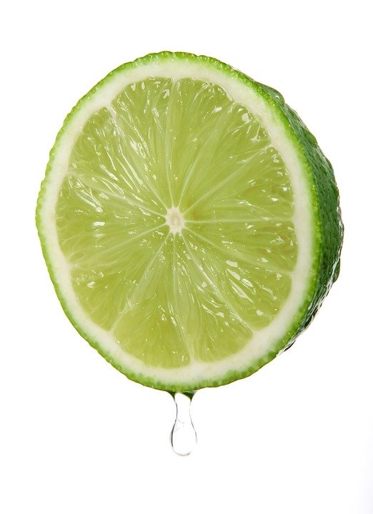
Lime Citrus Aurantifolia
Penny Price Academy
Saturday Club
Jjan 2024
Has a very fresh, juicy and zesty scent that really makes your mouth water. Not surprisingly it is recommended for digestive problems.
The oil is a good lymphatic stimulant and ideal for fatigue and a tired mind especially where there is apathy, anxiety and depression involved.
Works wonderfully well to bring up blends that smell too heavy or have too many base notes in.
Lime is uplifting to the mind and can help with motivation.
A lime hydrolat would be a great addition to water for it’s stimulating effect on the lymphatic system.

Slide 8
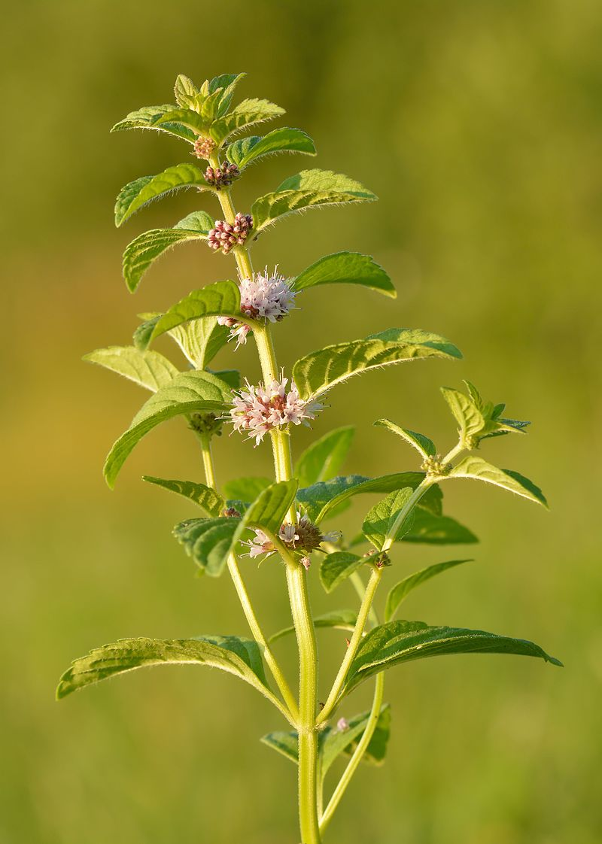
Peppermint Mentha piperata
Penny Price Academy
Saturday Club
Jan 2024
Peppermint can be used to help upset tummies and nausea it is likely that most people would have a mint essential oil over others.
This essential oil has a high menthol content and that can help if you have overindulged in food or alcohol. It is also stimulating and clearing to the mind.
The hydrolat can be added to water to help internally.

Slide 9
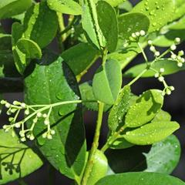
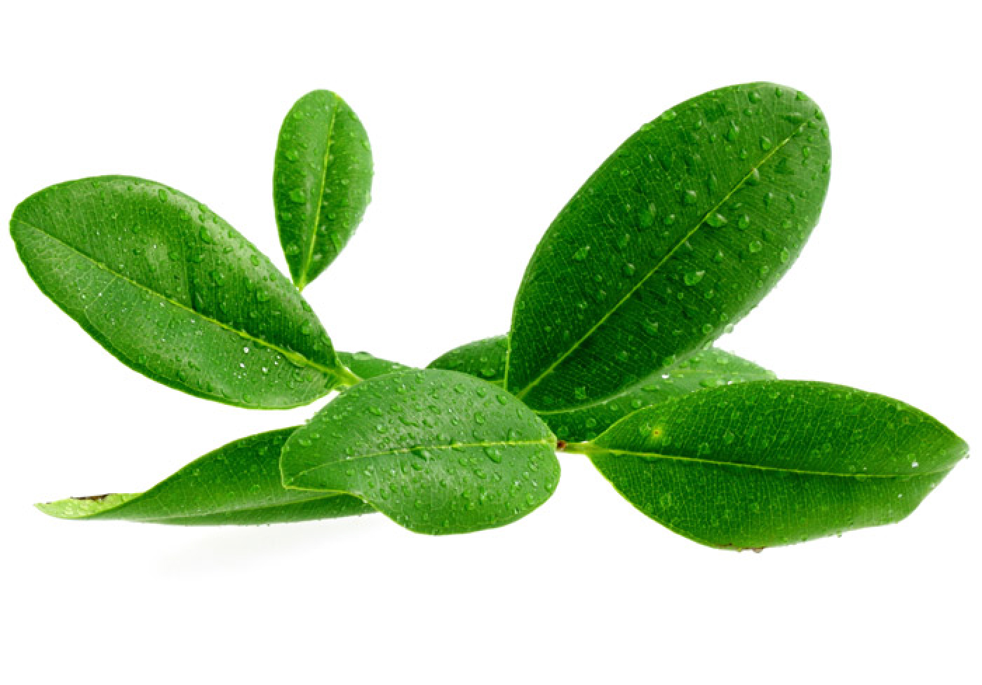
Ravensara
Ravensara aromatica
Penny Price Academy
Saturday Club
January 2024
Ravensara is a nerve tonic that can be used to revitalise people suffering from physical and mental fatigue allowing concentration on creating goals.
The oil is a great anti viral and immune system booster and often used in place of tea tree.
Increases concentration and allows the brain to utilise for activity.
Mailhebiau recommends it for people who doubt everything and no longer know where they are through lack of aims or ordeals.

Slide 10
Red Thyme Thymus vulgaris ct thymol
Penny Price Academy
Saturday Club
Jan 2024
The name comes from Greek work “thymon” meaning to fumigate as the oil is very cleansing both physically and mentally.
A well known digestive stimulant that promotes appetite, eases abdominal tension and aids digestion.
A phenol rich oil that is a real powerhouse and is a fantastic immunostimulant. When our diet is not as good our immune system can be compromised so it is worth using Eos that can boost it.
Mojay says that the antimicrobial properties of thyme can help counteract intestinal putrefaction, gastroenteritis and candida.

Slide 11
Methods of Application
Massage - by increasing circulation to the GI tract which in turn increases peristalsis, stimulates the large intestine which improves the elimination of waste, colon massage specifically helps to relieve constipation, IBS, bloating and gas.
Aromaflexology / Reflexology to stimulate the bodies own healing response.
Inhalation via diffuser or on a tissue for the quickest way into the bloodstream.
Internal pathways – teas, hydrolats and herbal infusions
Penny Price Academy
Saturday Club
Jan 2024

Slide 12
Conclusion
Penny Price Academy
Saturday Club
XXXX 2023
EXCLUSIVE 10% OFF ALL PRODUCTS!
Use Code XXXXXX until XX/XX/XX
Thank you for your continued support of Saturday club…

Slide 13
Thank you…
Penny Price Academy
of Aromatherapy
Saturday Club
xxxxxxxx

