Slide 1
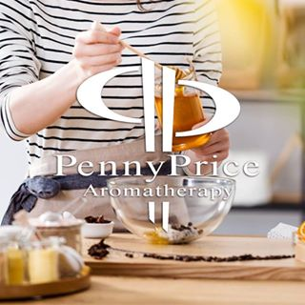
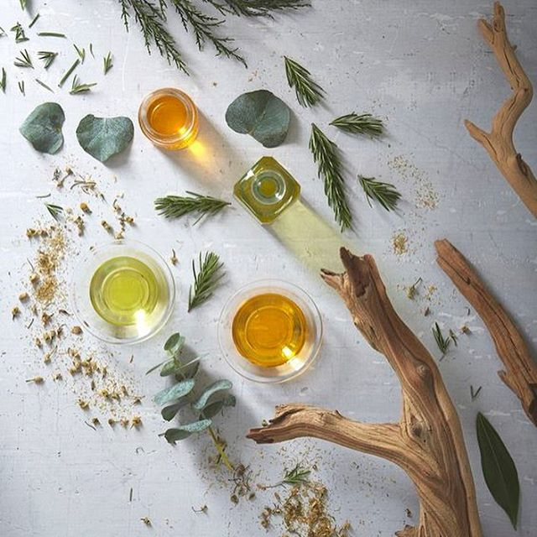
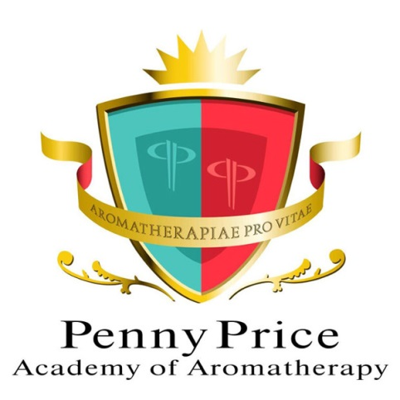
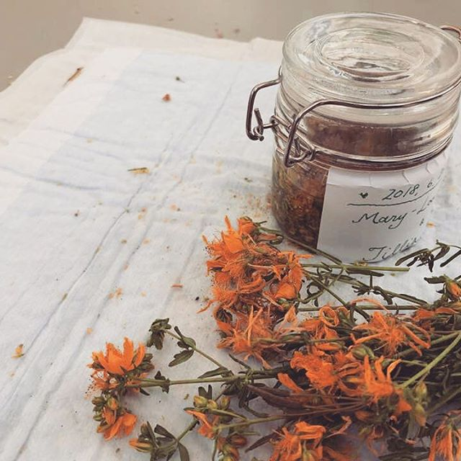
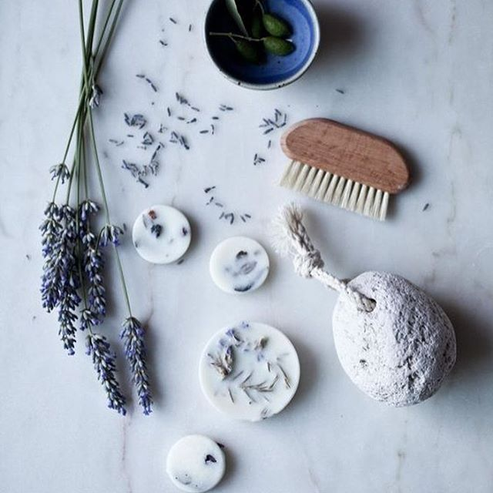
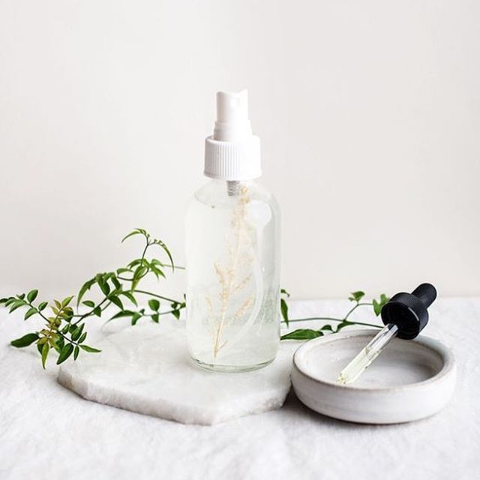
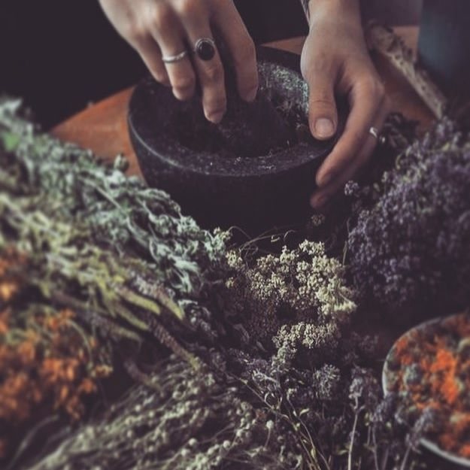
Essential Oils from Asia
With Louise Mac

Slide 2
Why Asia?
Penny Price Academy
Saturday Club
March 2024
Asia, the world’s largest and most diverse continent. It occupies the eastern four-fifths of the giant Eurasian landmass.
Asia has both the highest and the lowest points on the surface of Earth, has the longest coastline of any continent, is subject overall to the world’s widest climatic extremes, and, consequently, produces the most varied forms of vegetation and animal life on Earth.
It is this diversity that gives us a range of very useful essential oils.
This Photo by Unknown Author is licensed under CC BY-SA

Slide 3
Why Asia?
Penny Price Academy
Saturday Club
March 2024
Currently we have access to a global EO market but we can disassociate where our oils come from.
Focusing on a region we can refamilarise ourselves with what exactly in our box comes from where.
In this power point we will be looking at just a small selection of oils that come from Asia. Just with any market there are 100s more available.

Slide 4
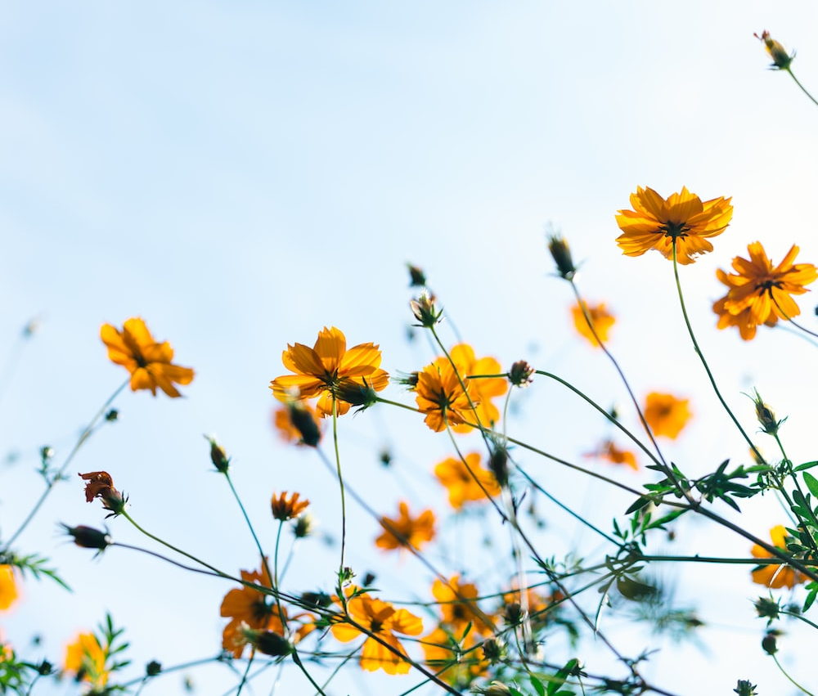
Penny Price Academy
Saturday Club
March 2024
A Selection of 7 Asian Oils

Slide 5
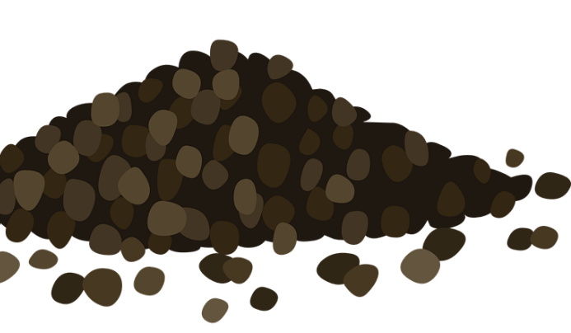
Black Pepper (Piper nigrum)
Penny Price Academy
Saturday Club
March 2024
Black pepper is full of terpenes and so it stimulating to the digestive system. It can help get things moving. It is said to stimulate the spleen into creating new blood cells.
A very warming and rubefacient oil makes it perfect for using in muscle/joint pain blends.
On an energetic level it will help us “get a move on” when we feel stuck in our lives.
It is anti spasmodic and carminative so it is recommended for dyspepsia, constipation and loss of appetite.

Slide 6
Cinnamon (Cinnamomum zeylanicum)
Penny Price Academy
Saturday Club
March 2024
Hot and stimulating oil that promotes motivation and puts the fire of courage in those who may have lost it.
Physically it can help with aches and pains and also digestive complaints that can be physiological symptoms of grief.
Restores a taste and vigour for life for those who are depressed.
Good for the circulatory system
Lembo states that cinnamon increases mental capacity to listen learn absorb and integrate all that is going on around you
This Photo by Unknown Author is licensed under CC BY

Slide 7
Ginger (Zingiber officinale)
Penny Price Academy
Saturday Club
March 2024
Ginger Essential Oil has earned the nickname “The Oil of Empowerment” for the feeling of confidence that it is known to inspire.
Used in aromatherapy applications, Ginger Essential Oil is stimulating and warming.
It can enhance concentration and it can soothe and reduce feelings of stress, sadness, anxiety, lethargy, agitation, dizziness, and fatigue.
Ginger is good for blood flow hence the warm feeling.
Worwood states the character of ginger is warming, strengthening and encouraging.

Slide 8
Lemongrass (Cymbopogon citratus)
Penny Price Academy
Saturday Club
March 2024
Lemon grass is analgesic, antiseptic, astringent, deodorising, insecticidal, sedative (nervous) and tonic.
Aldehydes make up somewhere between 66 and 85% of the oil.
Aldehydes are good pain relievers, especially for deep-seated pain.
They are also anti-inflammatory, immune-stimulating although can irritate the skin if applied neat.
Blended with alcohols and/or esters they calm the skin
This Photo by Unknown Author is licensed under CC BY-NC

Slide 9
Litsea May Chang (Litsea cubeba)
Penny Price Academy
Saturday Club
March 2024
Litsea is antimicrobial, anti-inflammatory, deodorising, digestive, insecticidal and sedative.
It is most used for acne, dermatitis, greasy skin and spots, nervous tension & stress.
Its enticing scent soothes the nervous system and helps us express our emotions in a more constructive manner.
Litsea Cubeba is the perfect antidote for seasonal blues, stress, anger and irritability.
It helps get rid of negative emotions and promotes relaxation, mental clarity and restful sleep.
This Photo by Unknown Author is licensed under CC BY-NC

Slide 10
Patchouli (Pogostemon cablin)
Penny Price Academy
Saturday Club
March 2024
A very grounding base note oil that also has great benefits for the skin.
Inhalation of patchouli essential oil vapour was associated with a 40% decrease in sympathetic nervous system activity in one study on 43 healthy women (Haze, Sakai and Gozu, 2002).
This suggests that patchouli oil is relaxing as elevations in sympathetic nervous system activity is associated with stress.
This Photo by Unknown Author is licensed under CC BY-NC

Slide 11
Vetiver (Vetiveria zizanioides)
Penny Price Academy
Saturday Club
March 2024
An excellent oil for mental fatigue and busy minds.
Native to Indonesia and Sri-lanka, it is often used in traditional massage oils to help promote deep and relaxing sleep and to help lift depression, and is known as ‘the oil of tranquility’ (Lawless, 1995).
Vetiver Essential Oil contains approximately 50% Sesquiterpenes and around 20% Sesquiterpenols making it very relaxing, grounding and well suited for emotional and spiritual application
This Photo by Unknown Author is licensed under CC BY-SA-NC

Slide 12
How to use…
Penny Price Academy
Saturday Club
March 2024
Diffuser or nasal inhaler
Combined with a meditation practice
Creating bespoke blends such as bath oils or pulse point rollerballs
In Massage or other holistic treatments
Remember to always use the 3 drops to 10ml rule when blending.

Slide 13
Saturday Club 10% Discount Code
EOASIA
Black Pepper
Cinnamon Leaf
Ginger
Lemongrass
Litsea
Patchouli
Vetiver

